Slide 1

PRESENTATION
KHARAGPUR DATA SCIENCE HACKATHON
Problem Statement:
Algorithmic Trading Model Development for
BTC/USDT Crypto Market
TEAM-DATASTARS

Slide 2
APPROACH
AUTOARIMA MODEL
Why AutoARIMA is Suitable for the Dynamic and Non-linear Nature of Crypto Market Data:
1.Adaptable to Non-Linear Trends
2.Handles Volatility and Market Dynamics
3.Captures Seasonal Patterns

Slide 3

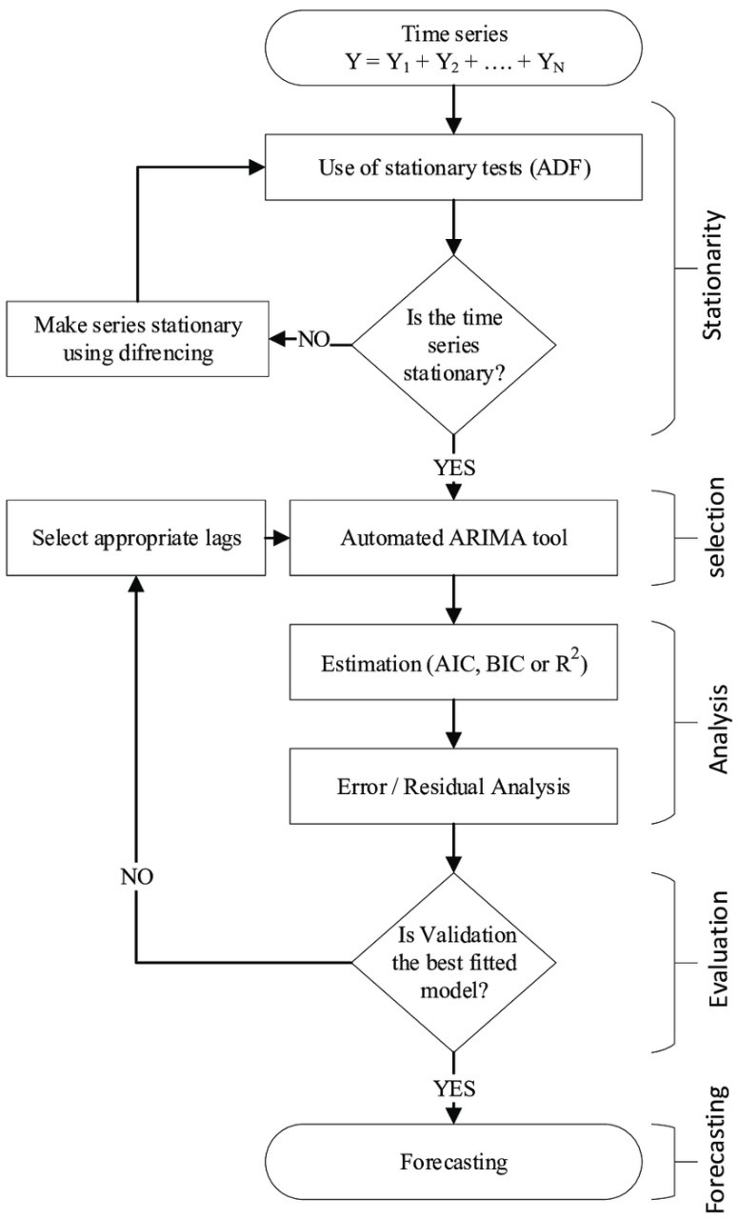
FLOW CHART

Slide 4

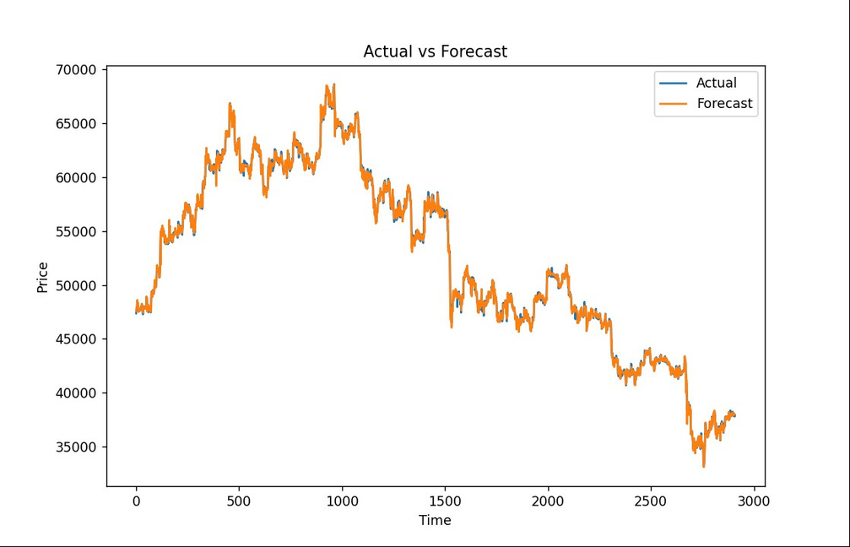
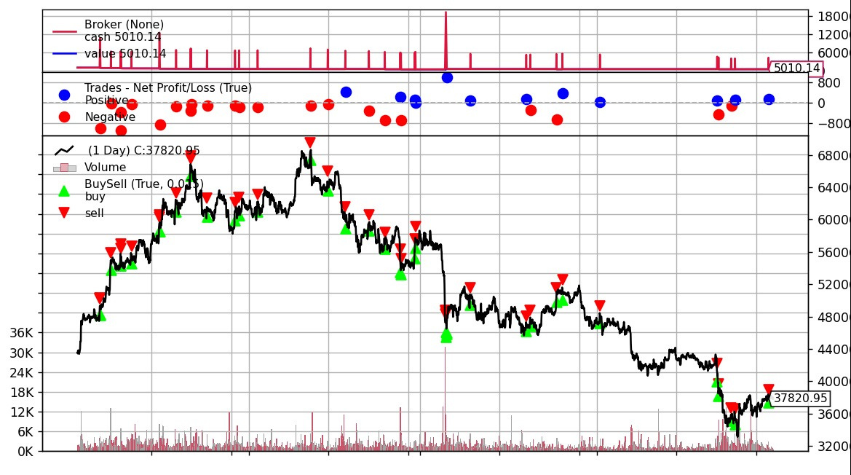
BACKTESTING RESULTS

Slide 5

HERE ARE THE METRICES RESULT OF OUR
MODEL
1.Gross Profit: 4632.630000000005
2.Net Profit: -815.8799999999974
3.Total Closed Trades: 34
4.Win Rate: 55.88%
5.Gross Loss: 5448.510000000002
6.Average Winning Trade: 243.8226315789476
7.Average Losing Trade: 363.23400000000015
8.Buy and Hold Return: 44.96%
9.Average Holding Duration per Trade: 1.0
10.Max Drawdown: 303865.00%
11.Sharpe Ratio: -2.712737203706029
12.Sortino Ratio: -2.2461555894136462
13.Largest Losing Trade: 970.6200000000026
14.Largest Winning Trade: 1375.1600000000108
15.Max Dip in Running Trade: 3037.6500000000087
16.Average Dip in Running Trade: 232018.04294119054
17.R2 Score: 0.9993828972526454

Slide 6

RISK MANAGEMENT APPROACH
Stop-Loss Orders:
Emphasize the use of stop-loss orders to limit potential losses.
Discuss setting stop-loss levels based on technical or fundamental analysis.
Hedging:
Introduce the concept of hedging to offset potential losses.
Highlight how derivatives or inverse assets can be used for hedging.
Continuous Monitoring:
Stress the importance of ongoing monitoring of positions and market conditions.
Discuss the role of real-time data in making informed risk management decisions.

